Slide 1
Study Works
Study Works – study your work

Slide 2
Inhalt
What is it about?
Belongings
Team members
projekt

Slide 3
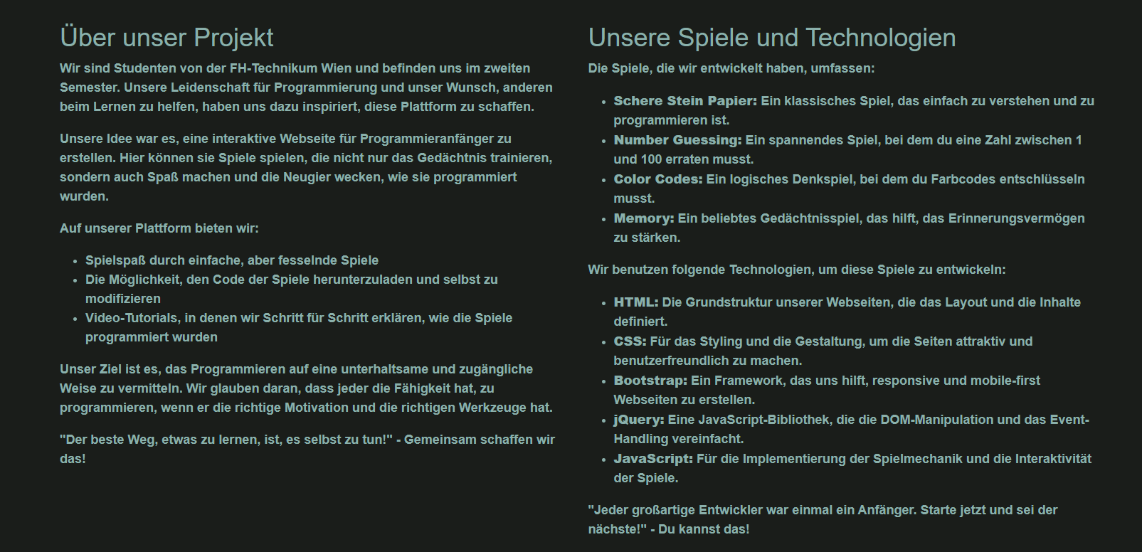
What is it about?
Homepage
Spiele
Tutorial-videos
Eigne Sourcecodes

Slide 4
Belongings
Studenten
Begeisterte von informatik
Erleichterung und freude am programmieren
Java script

Slide 5
Team Members
Akintayo Michael Akinrinlola – head of design
Kevin Anthony – Git Master
Mohamed nasr – Director
Raphael najfar – quality manager

Slide 6
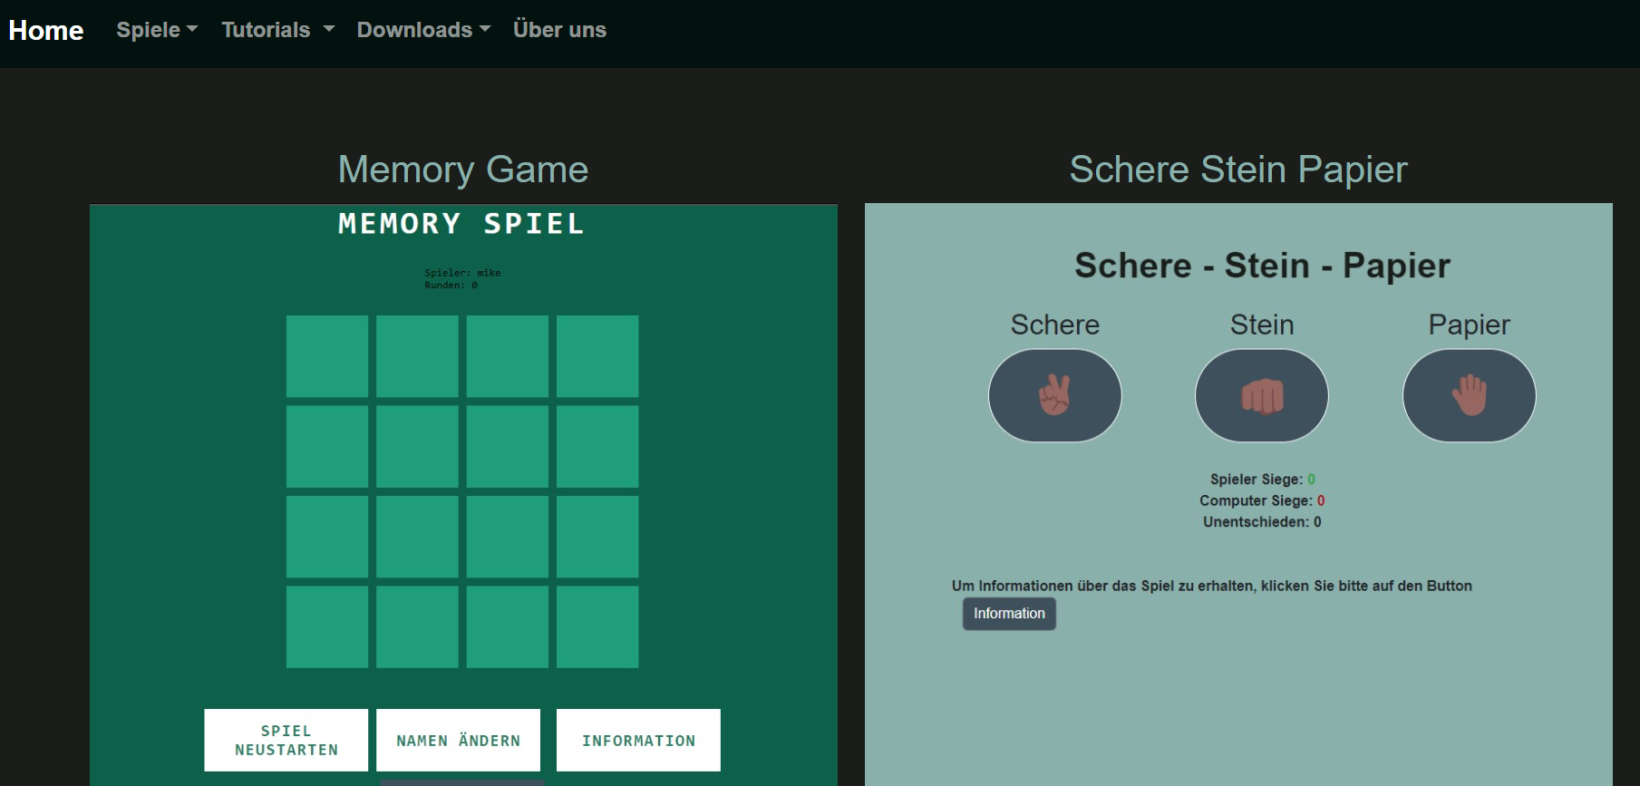
homepage

Slide 7
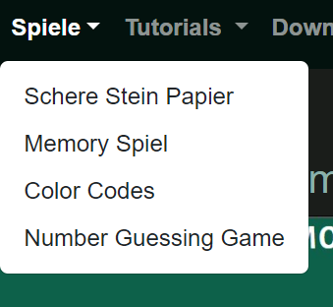
Zugang über navbar

Slide 8
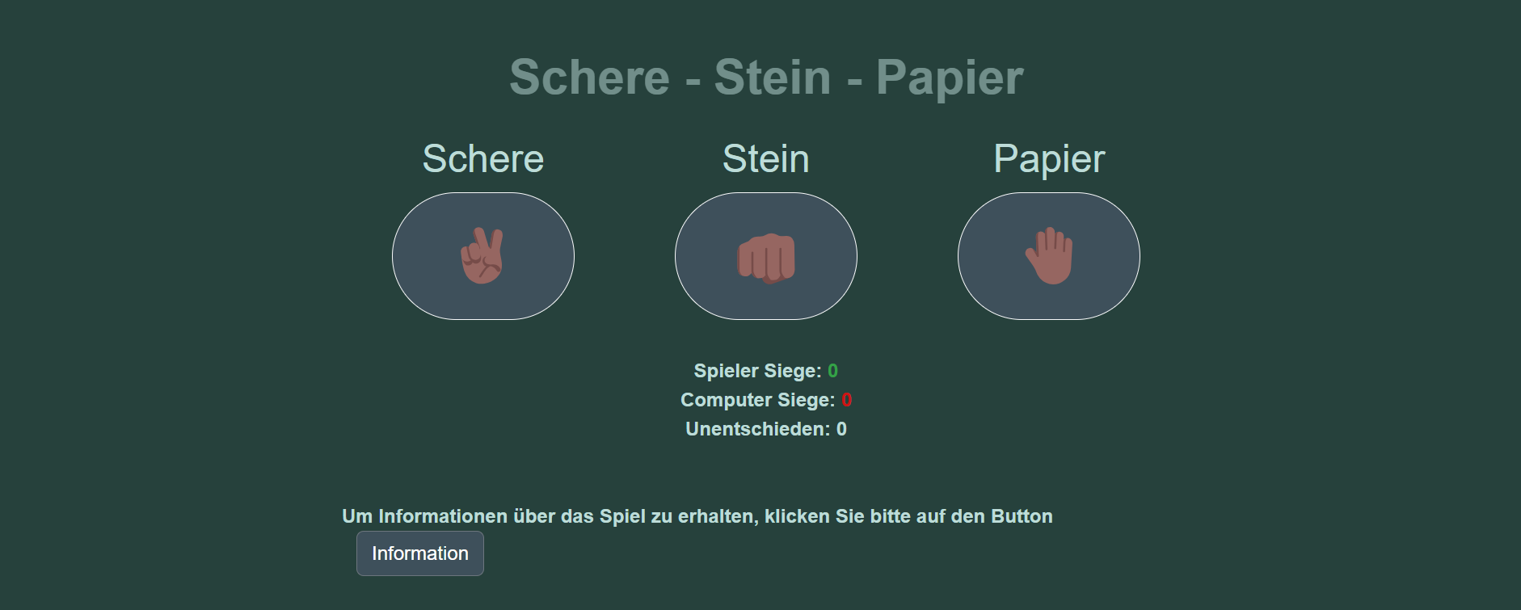
Schere Stein papier

Slide 9
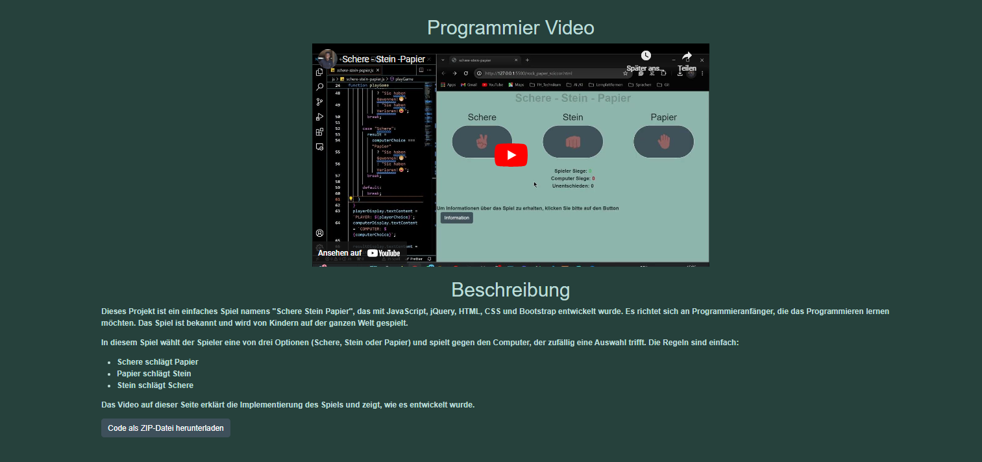
Schere Stein papier - Information

Slide 10
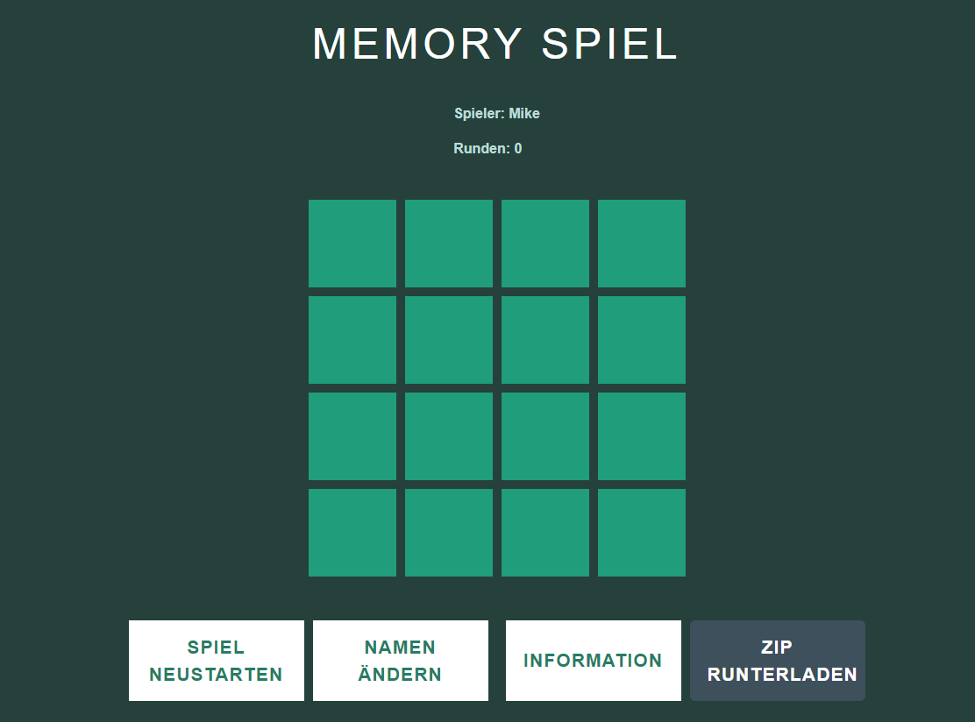
memory

Slide 11
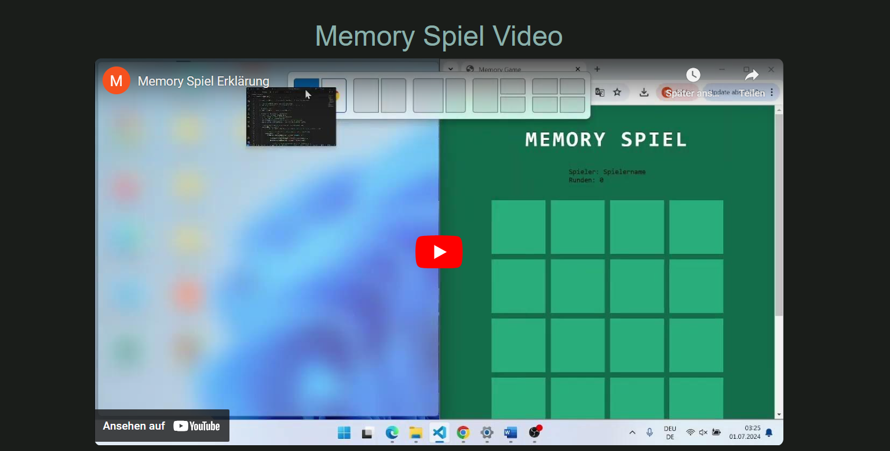
Memory - Information

Slide 12
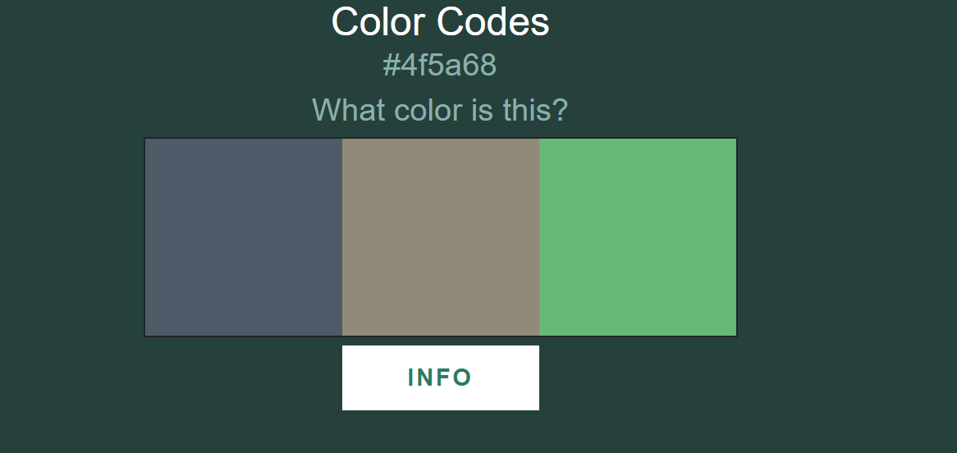
Color Codes

Slide 13
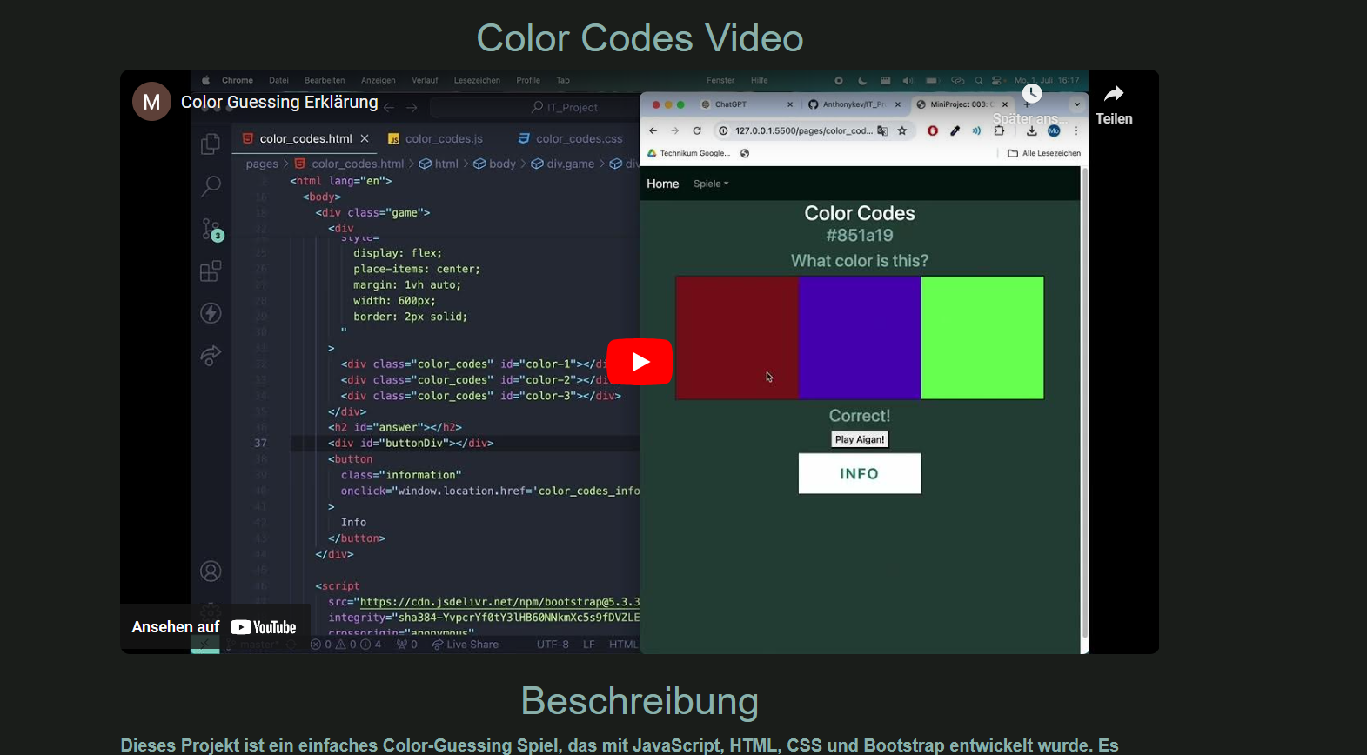
Color codes - information

Slide 14
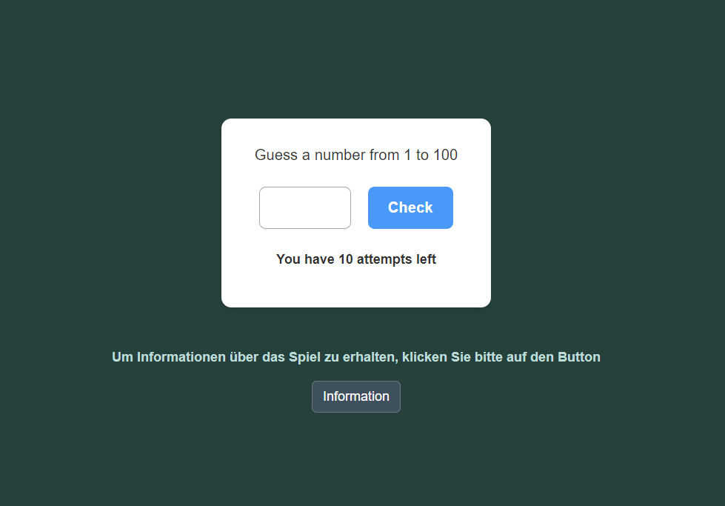
Number guessing game

Slide 15
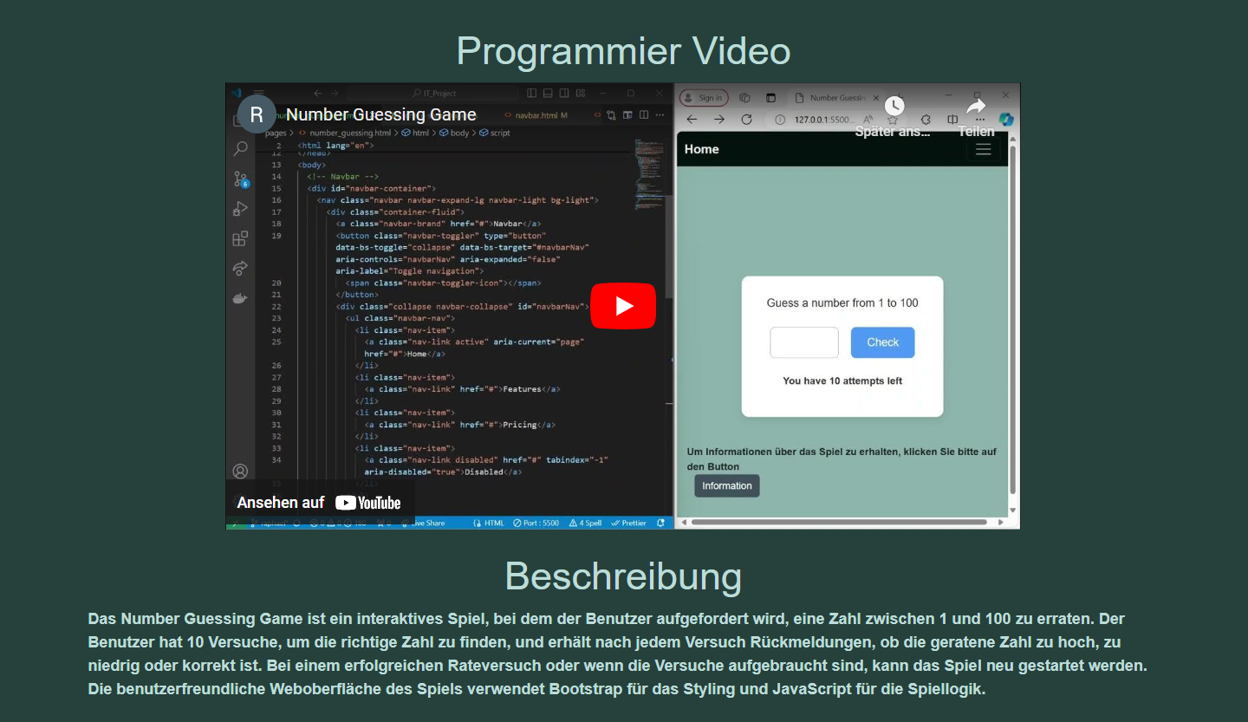
Number guessing game - information

Slide 16
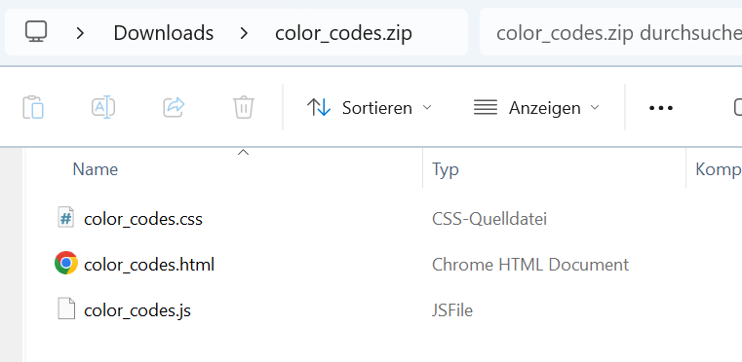
Downloads - zip

Slide 17
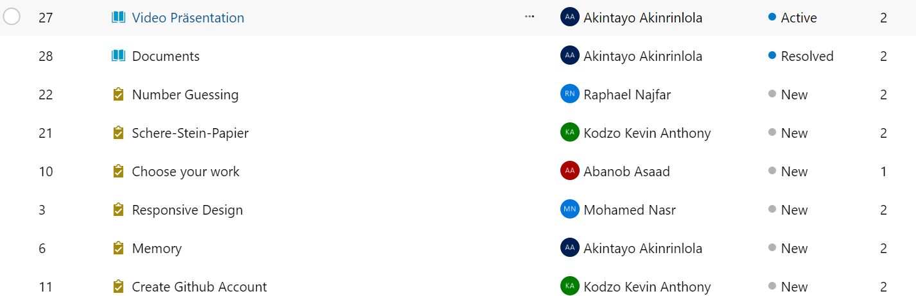
DevOps

Slide 18
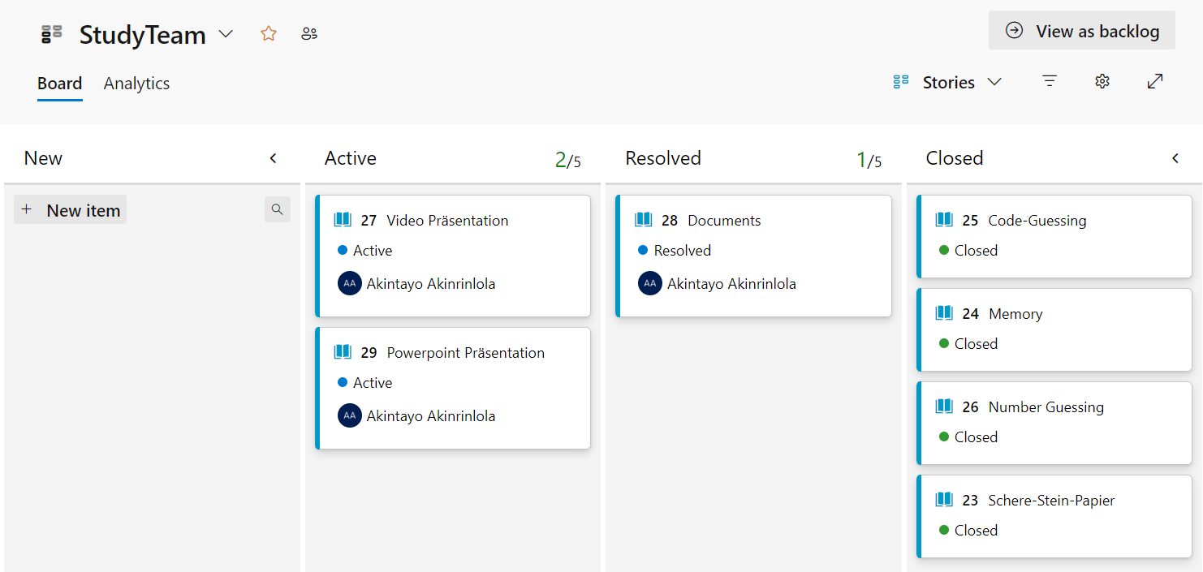
devops

Slide 19
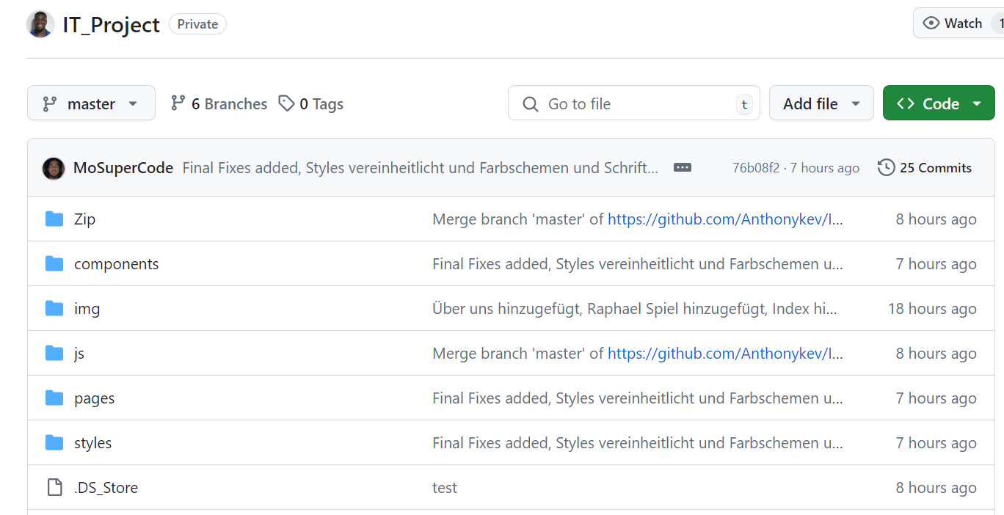
github

Slide 20
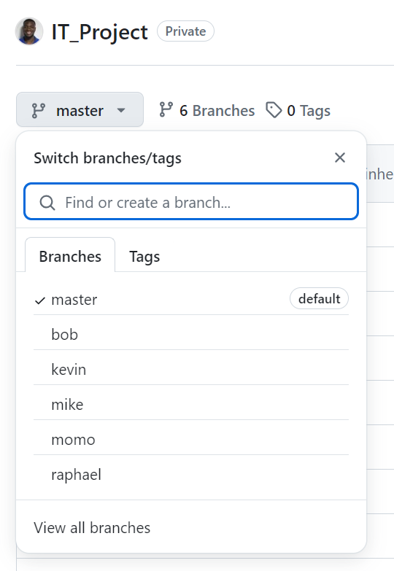
github

Slide 21
Vielen Dank für eure Aufmerksamkeit!!!!

